Slide 1
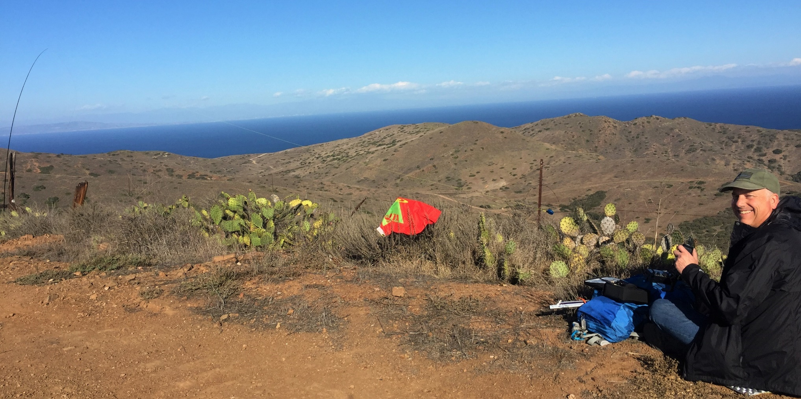
Summits On The Air
Mountain Top Activations and Amateur Radio
Presented by:
Scott Bastian- AK6Q
Catalina Island

Slide 2
Summits on the Air
How did it start?
What is it?
How do I participate?
Can I get any awards?
How do I start activating and what equipment should I use?
Safety and Operating

Slide 3
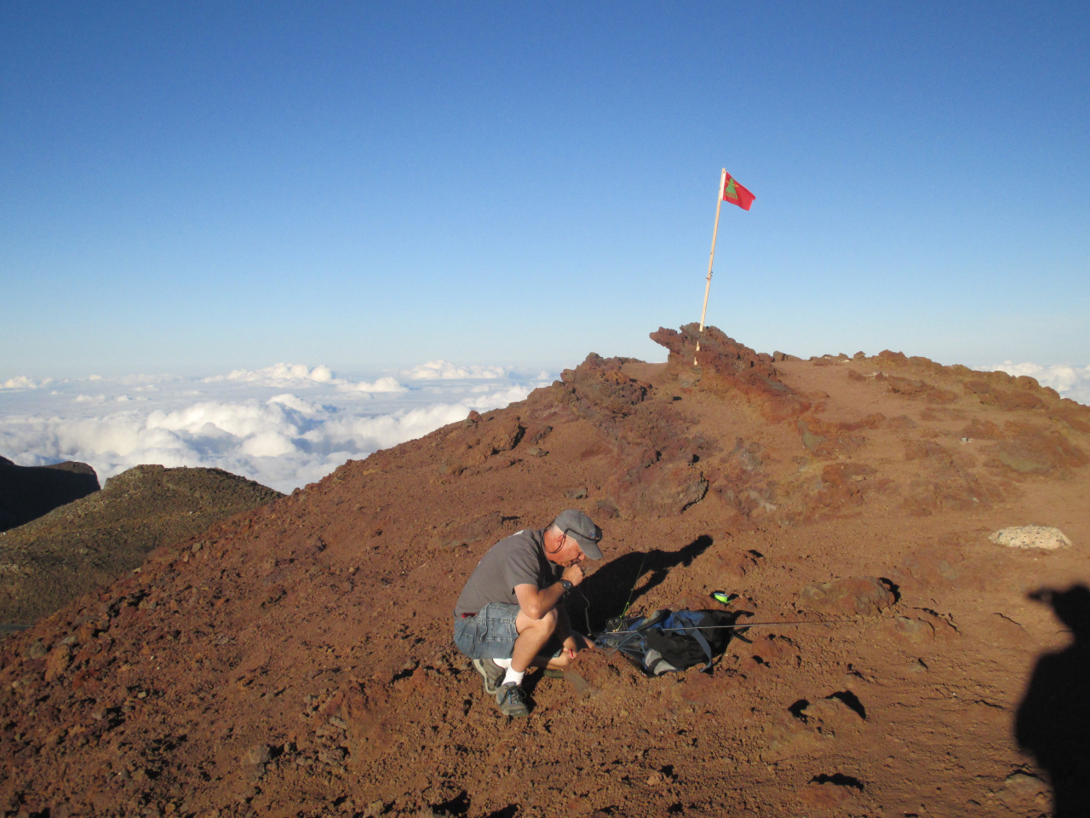
"For as long as there has been radio, amateurs have taken their stations to the tops of mountains It’s perhaps a little surprising that no formal program for activating summits existed until March 2002!”
Halleakala, HI

Slide 4
How did SOTA start?
Original idea of John, G3WGV
Developed with Richard, G3CWI
Launched on March 2nd 2002
Internet based activity
Industrial strength database
Over 2 million QSO's in SOTA Database
Thousands of registered users
Sophisticated web portal
Alerting, spotting, forum, etc
55 participating countries and over 60,000 peaks in the SOTA database and growing fast

Slide 5
Summits on the Air
How did it start?
What is it?
How do I participate?
Can I get any awards?
How do I start activating and what equipment should I use?
Safety and Operating

Slide 6
What is the SOTA program?
"Summits on the Air (SOTA) is an award program for radio amateurs and shortwave
listeners that encourages portable operation in mountainous areas. SOTA has been carefully
designed to make participation possible for everyone - this is not just for mountaineers!
There are awards for Activators (those who
ascend to the summits) and Chasers ( those who either operate from home, mobile or even on another Peak (S2S)
From www.sota.org.uk

Slide 7
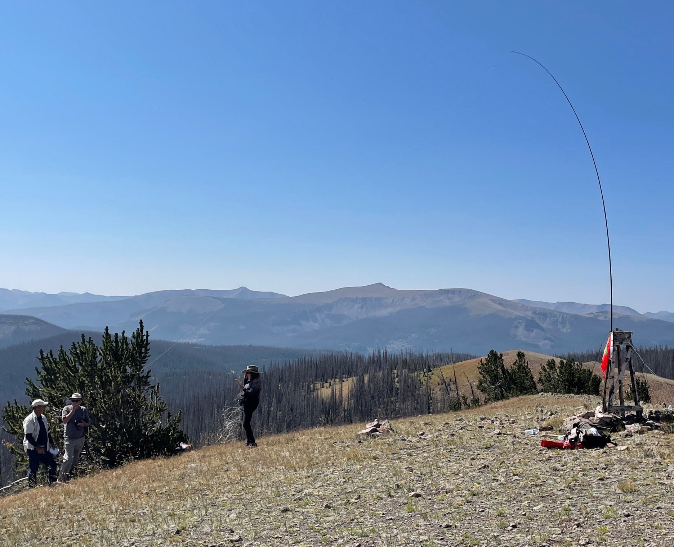
Scott AK6Q, Paul AC5S, Randy K0TNG, Rocky WB5NJU , Snowshoe Peak near Creed

Slide 8
General SOTA Principles
Two ways to participate
Activator
Chaser
Points and Award System
1805 SOTA summits in Colorado
A wide variety of difficulty and elevation
From 5324 feet to 14,443 feet
SOTA activation requirements:
summit MUST be on the SOTA list
Activation Zone (AZ) is within 25m (82 ft) of the summit
equipment must be carried (no minimum distance)
portable power no fossil fuel generators or vehicle power

Slide 9
When is a peak not a SOTA peak?
Peak qualification rules:
Prominence must be greater than 500 ft/150m from surrounding peaks
(333 ft/100m for Oklahoma)
Peaks may be on private or government property
Private property with permission only
NO TRESSPASSING
Respect for Native American and Government properties
(Not all qualified peaks are in the database new ones are added as managers update/grow the data base)

Slide 11
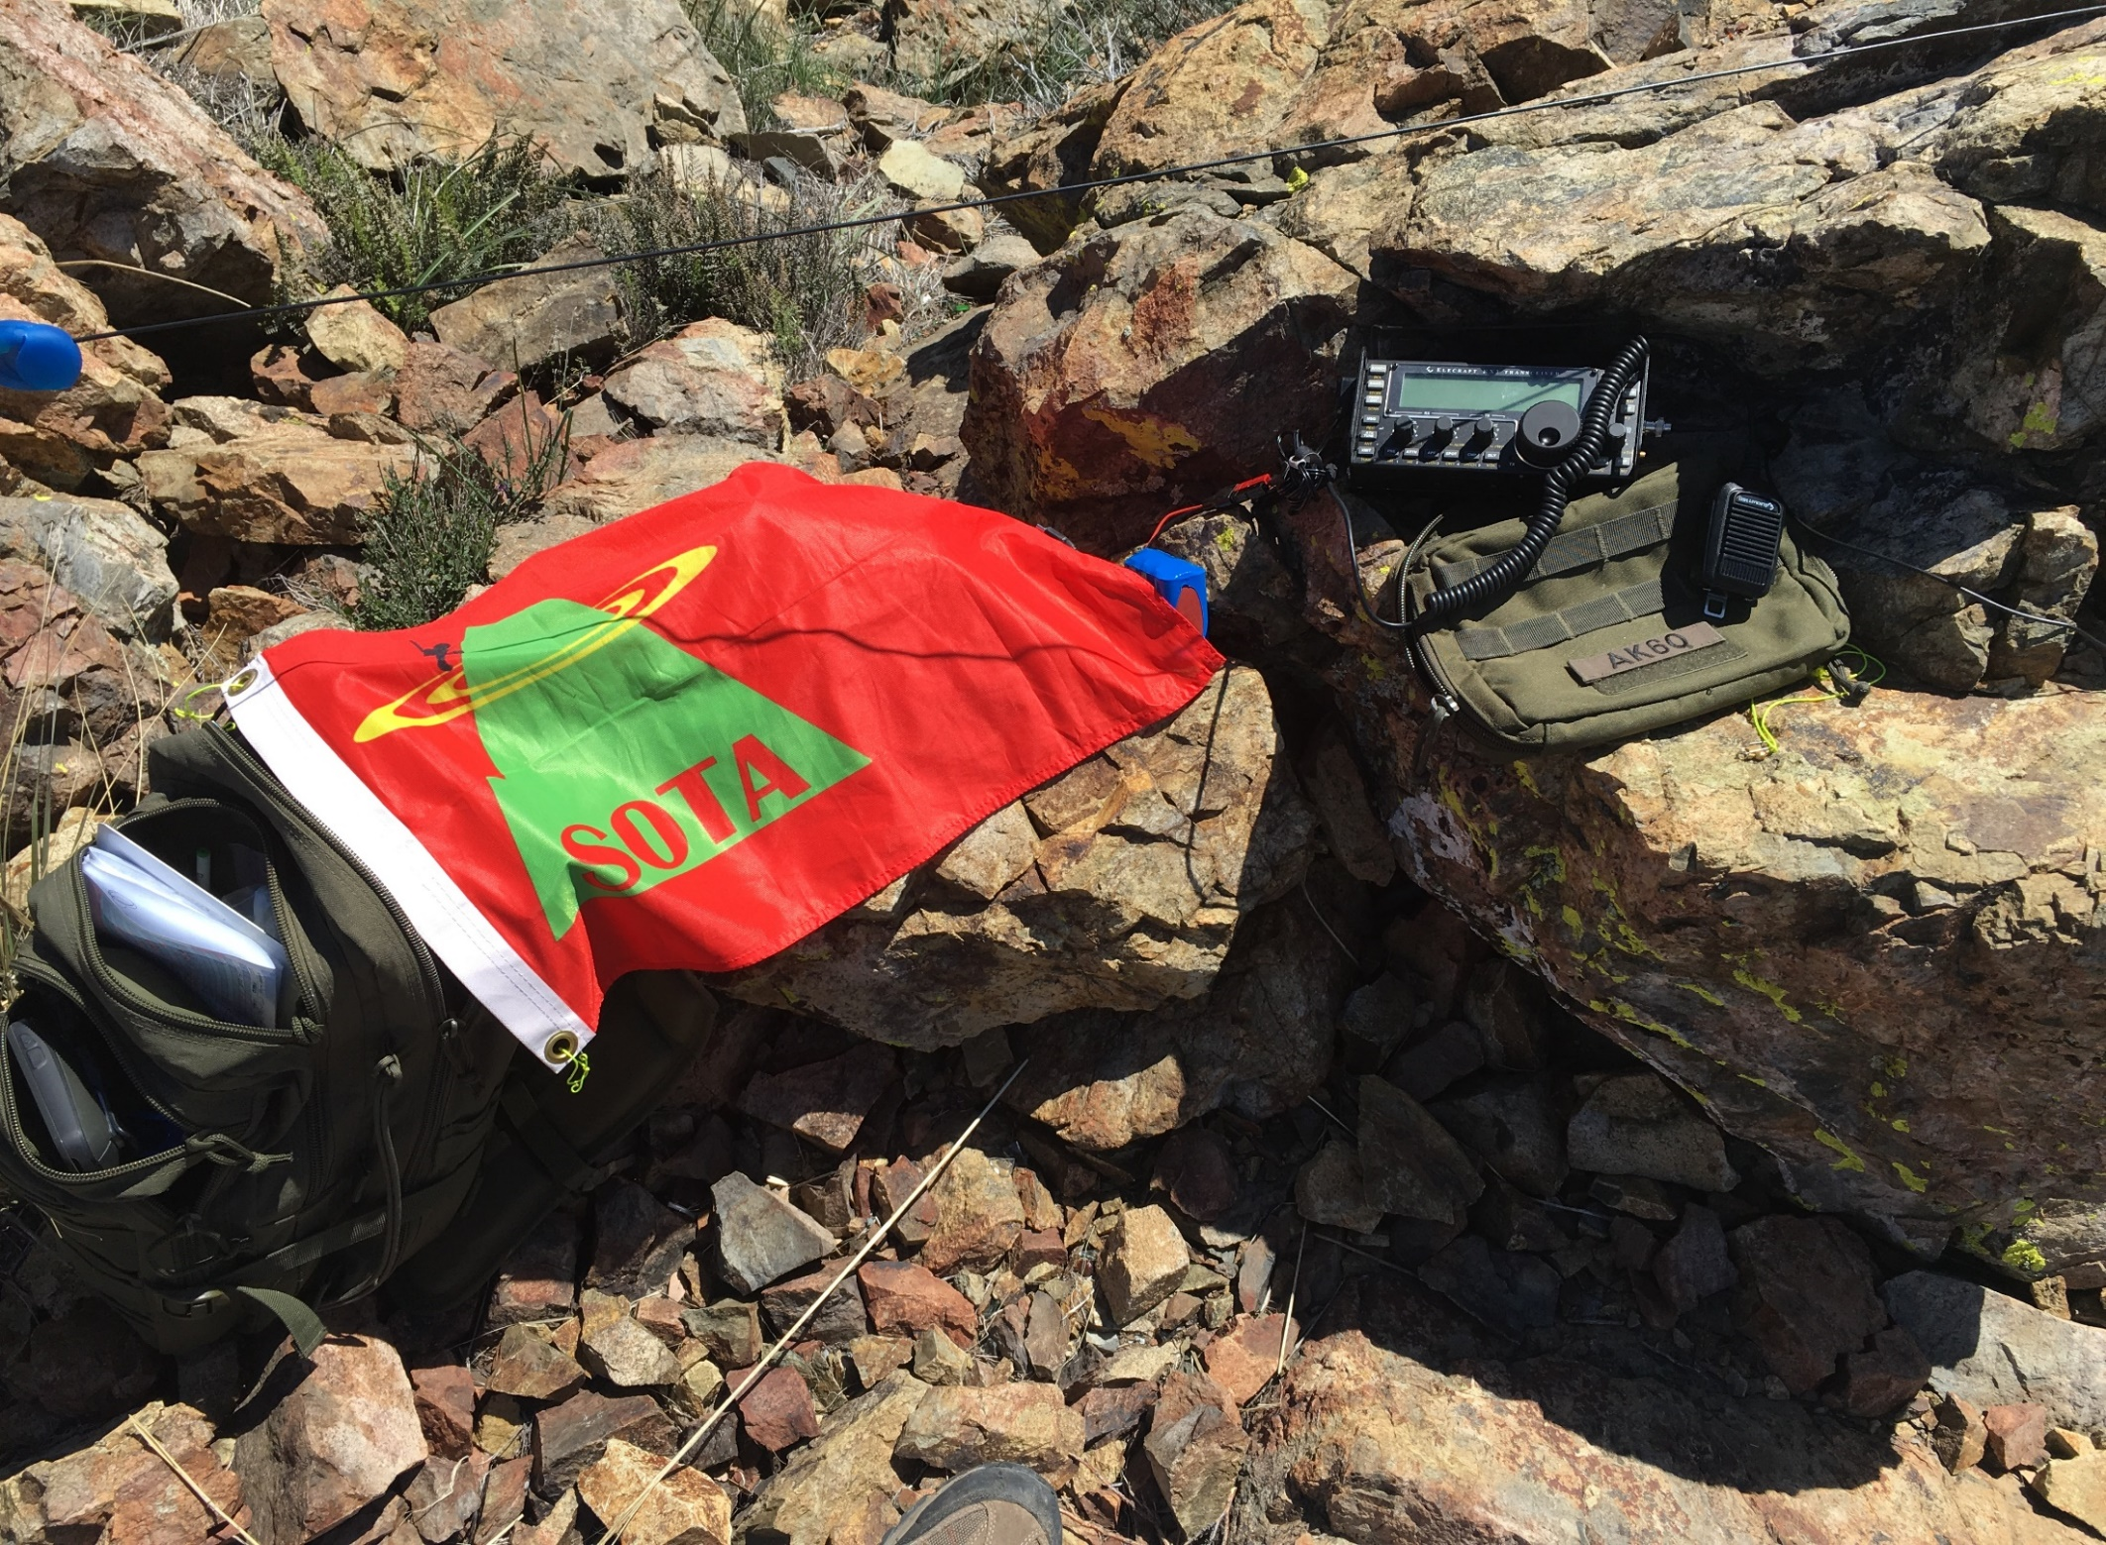
Selected SOTA Associations
Some of the US Associations
W0C - USA Colorado
W0D - USA Dakotas
K0M- USA Minnesota
W5O - USA Oklahoma
W7A - USA Arizona
W7M - USA Montana
W7Y - USA Wyoming
W7I- USA Idaho
W7W -USA Washington
As of Apr 2011

Slide 12
SOTA Scoring
Based on ASL elevation of a qualified peak
Points Varies by Association
Same principles for Chasers and SWLs
May include a "seasonal bonus" for activators
Colorado has a 3pt bonus for Dec 1- Mar 31 (>9k)
Scoring for W0C Colorado: 1805 Peaks
Under 8000' | 1 point
8000' to <9000' | 2 points
9000' to <10,500' | 4 points
10,500' to <12,500' | 6 points
12,500' to <13,500' | 8 points
13,500' + | 10 points
Notes:
Min. height for bonus 9000 ft Bonus period dates 1 December to 31 March inclusive Association sponsored awards No Association Awards at this time Association Manager Matt Schnizer - K0MOS k0mos@schnizer.com

Slide 13
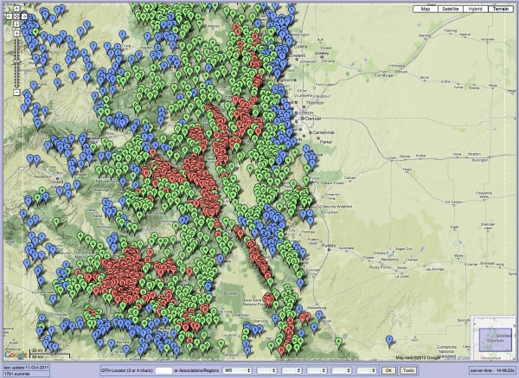
W0C Peaks in database
.

Slide 14
Summits on the Air
How did it start?
What is it?
How do I participate?
Can I get any awards?
How do I start activating and what equipment should I use?
Safety and Operating

Slide 15
Participation Roles
Activators - those who "activate" a peak
Need 4 QSO any band to get points
Chasers - those who work the activator
Need only the one QSO to get points
Short Wave Listeners - those who can confirm a QSO get same points
Notes:
Any license class can participate….. 2 of our Colorado Mountain Goats have done VHF/UHF only for 1,000 points!

Slide 16
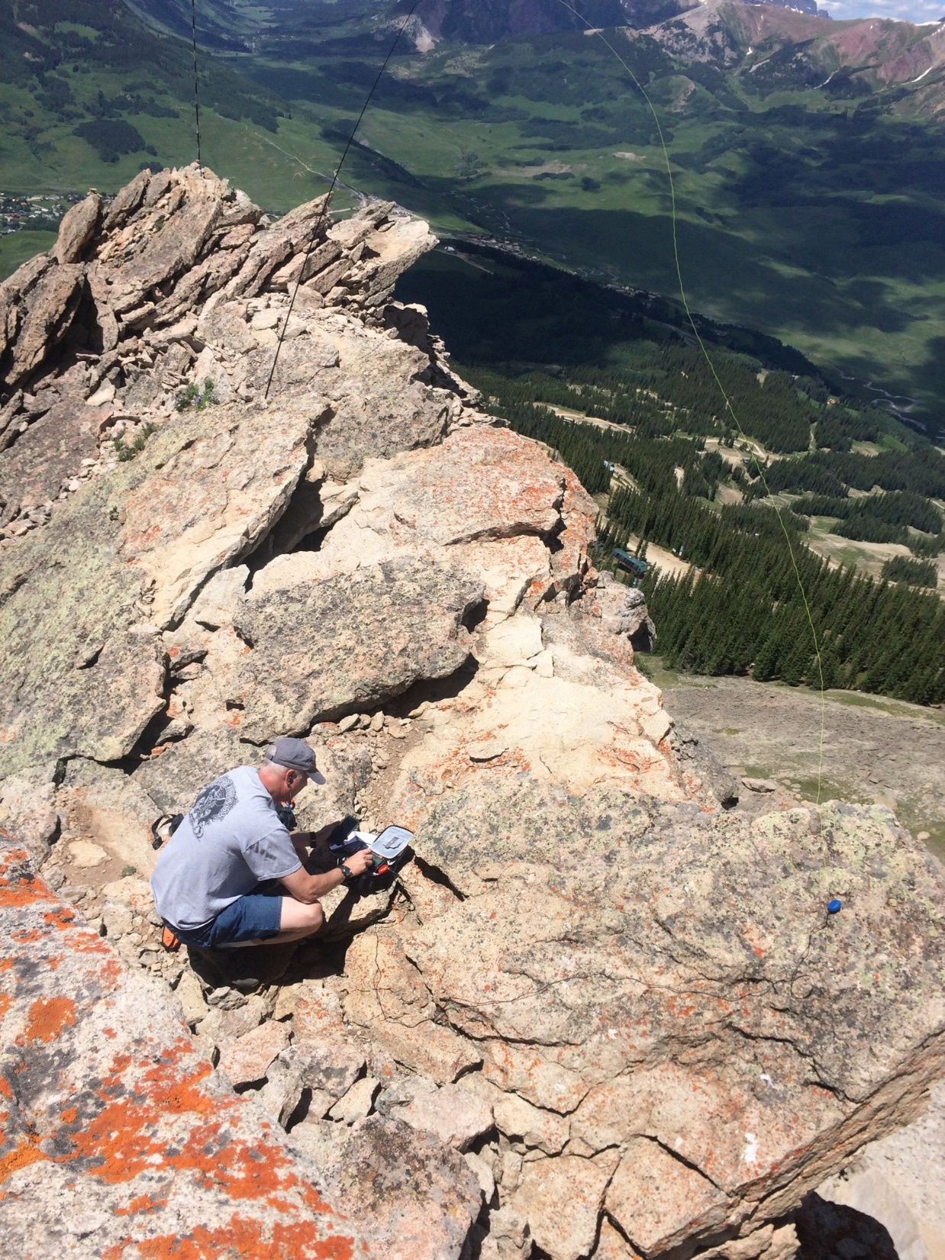
Mt Crested Butte

Slide 17
Web Tools for SOTA
www.sota.org.uk
The main site about the SOTA program
www.sotawatch.org
Alerts, spots, map, and a forum
Register to participate
https://www.sotadata.org.uk/en/
Log QSO’s both Activator and Chaser
Register to enter QSO's and see more detail
WØC SOTA (wØc-sota.org)
Lots of Colorado SOTA information
Notes:
Will talk more on these tools/links

Slide 18
Summits on the Air
How did it start?
What is it?
How do I participate?
Can I get any awards?
How do I start activating and what equipment should I use?
Safety and Operating

Slide 19
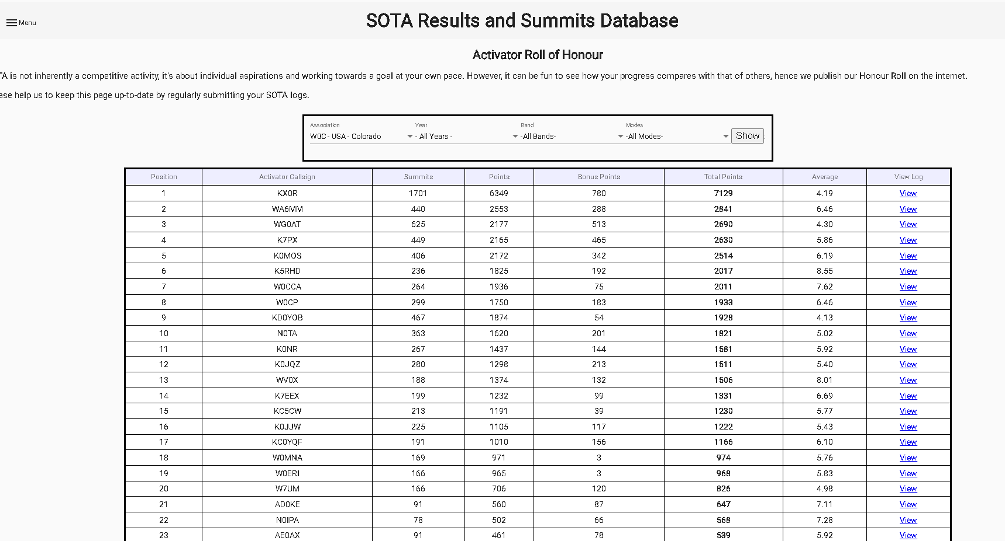
Activator Roll of Honor

Slide 20
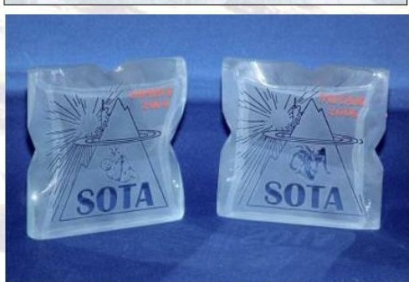
SOTA Awards
Certificates
100, 250 and 500 points
Mountain Goat
1000 activating points
Shack Sloth
1000 chasing points
SWL
Association awards
Further certificates at 2500, 5000, 10000 points

Slide 21
Summits on the Air
How did it start?
What is it?
How do I participate?
Can I get any awards?
How do I start activating and what equipment should I use?
Safety and Operating

Slide 22
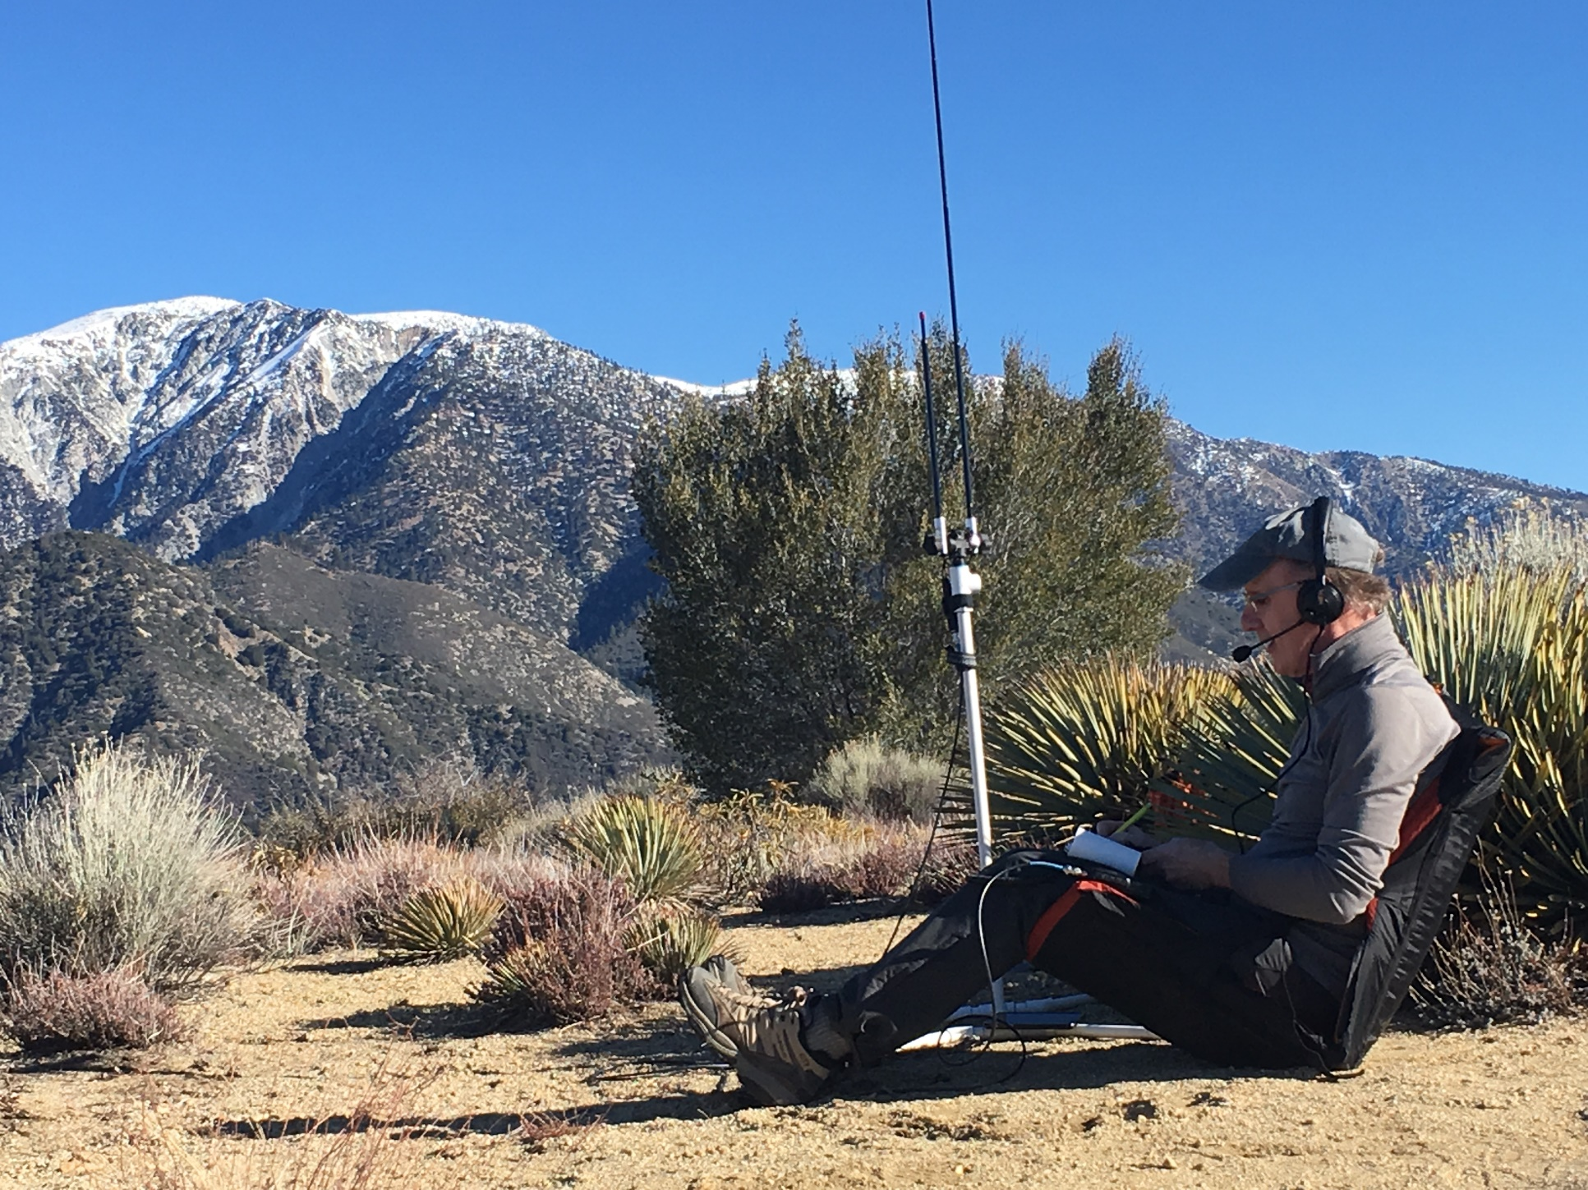
Bands and Modes
VHF and UHF
A lot of 2m FM 146.580mhz
SSB is popular
CW is also used occasionally
HF
A lot of CW, due to use of QRP equipment
- 10118 kHz, 14060 kHz, 14285kHz are
Popular watering holes
Sunset Pk Paul W6PNG

Slide 23
Principal Rules for Activators
Cannot use motorized transport to summit
but you can drive up close to it
Must operate from portable power source
Must carry all equipment to summit
Must make at least four QSOs
Any mode, any band
QSO's via repeaters don't count
Exception is via satellite

Slide 24
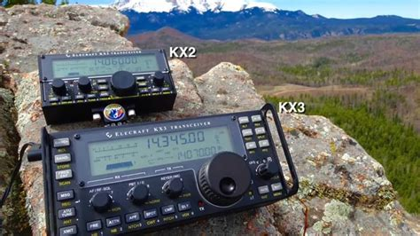
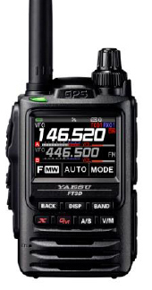
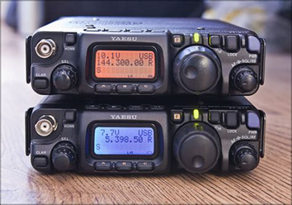
Typical SOTA Equipment
Elecraft KX2 and KX3
It's all a lot easier these days!
Equipment is smaller, lighter and more efficient
Battery technology has improved immensely
Yaesu FT817 and FT818
Any HT is good… but you need more antenna

Slide 25
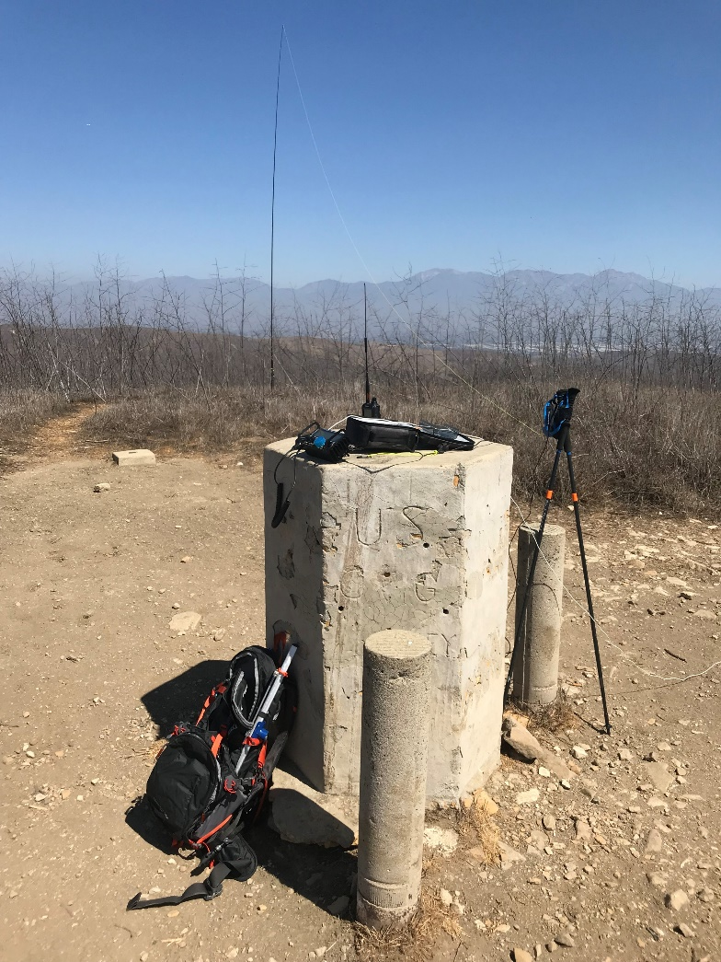
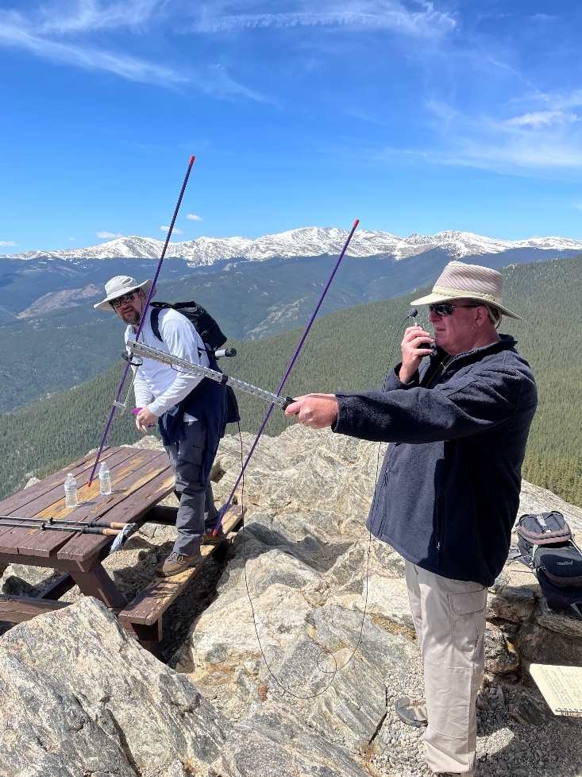
Typical SOTA Antennas
VHF/UHF Arrow Yaggi / Log Periodic
HF (Dipole, EFHW, OCFD)
& Fiberglass Pole / string for throwing in a tree

Slide 26
HF or VHF/UHF?
Take Your Pick, Or Do Both
VHF/UHF
Height Above Average Terrain
Basic/compact equipment: Handheld Transceiver (HT)
Dependent on local chasers
FM most common, SSB for VHF contests
Technician Licensees can play!!!
HF
Classic QRP operating (CW and SSB)
Longer distance contacts
More radio contacts
Recommended: General License Class or higher
(unless on CW)

Slide 27
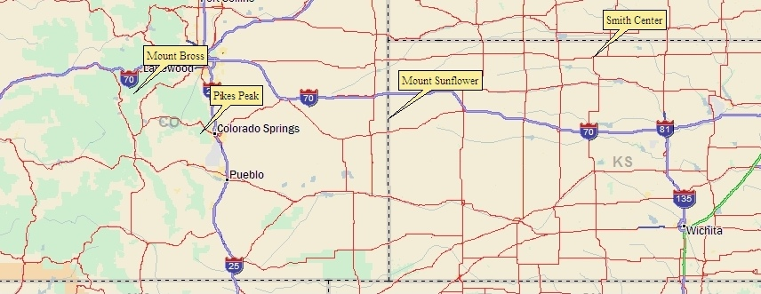
How Far Will My Signal Go on VHF?
Optical horizon from Pikes Peak: 120 miles, plus 15% for radio horizon = 138 miles
Mt Sunflower (highest spot in Kansas) is easily worked on 2m FM from Pikes Peak (160 miles)
Best DX between two 14er summits on 2m FM (Colorado 14er Event):
Andy AAØCM on Longs Peak to Jan W3GEY on Sunshine Peak (188 miles)
Best 2m FM DX during Colorado 14er Event: Phil NØKE on Mt Bross to Larry NØLL near Smith Center, KS (375 miles)
Bob Witte, KØNR

Slide 28
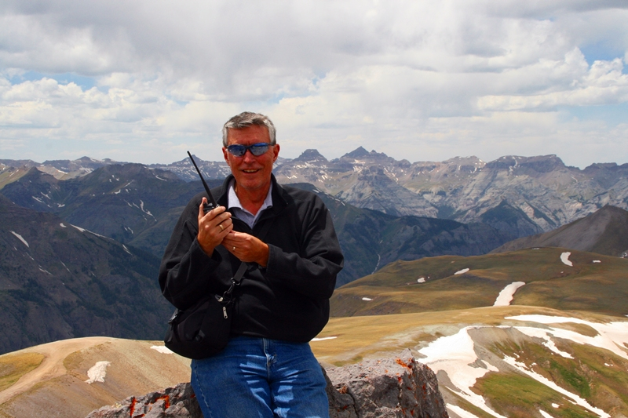
No Rubber Duck Antennas
A rubber duck antenna is the world’s most convenient crappy antenna.
BAD
Bad bad bad bad bad bad bad bad bad bad bad bad bad bad bad bad bad bad bad bad bad bad bad bad bad bad bad bad bad bad bad bad bad bad bad bad bad bad bad bad bad bad bad bad bad bad bad bad bad bad bad bad bad bad bad bad bad bad bad bad bad bad bad bad bad bad bad bad bad bad bad bad bad bad bad bad bad bad bad bad bad bad bad bad bad bad bad bad bad bad
Bob Witte, KØNR

Slide 29
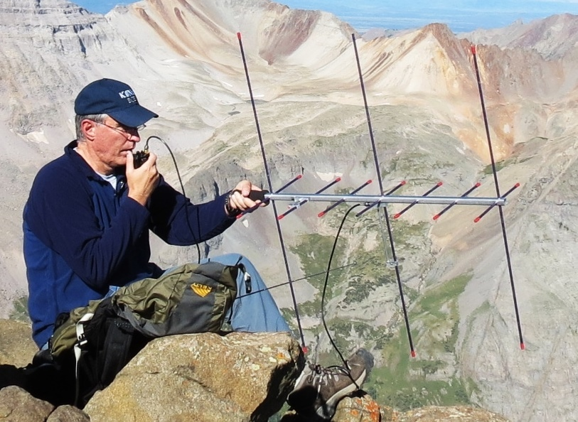
Arrow II VHF/UHF Yagi Antenna
Bob KØNR
Mt Sneffels
Crossed Yagi Design
Two antenna connections, or use duplexer
2m gain= 5.9 dBd
70cm gain= 8.2 dBd
(2009 CSVHFS)

Slide 30
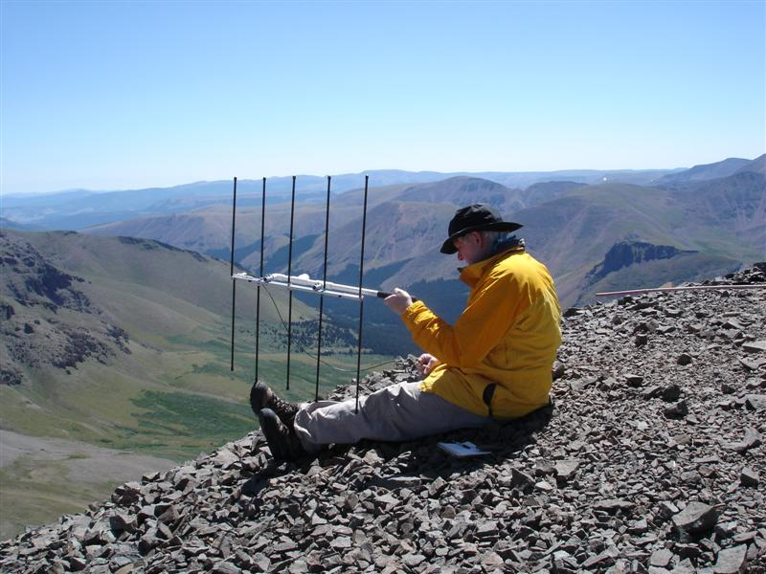
Elk Log Periodic Antenna UHF/VHF
Scott ACØFQ
San Luis Peak
One feedline connection for 2m & 70 cm
Same polarization on both bands
2m gain= 6.6 dBd
70cm gain= 7.0 dBd
(Mfg datasheet)

Slide 31
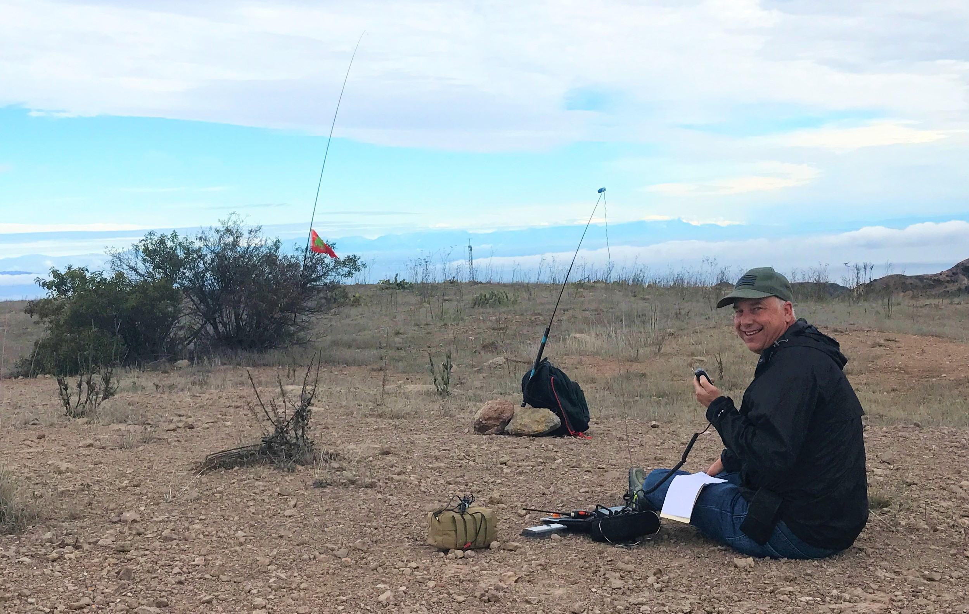
HF Operations Frequently get to be the pile up! Lots of DX Opportunities
Radios
Antennas
Mt Orizaba Catalina Island

Slide 32
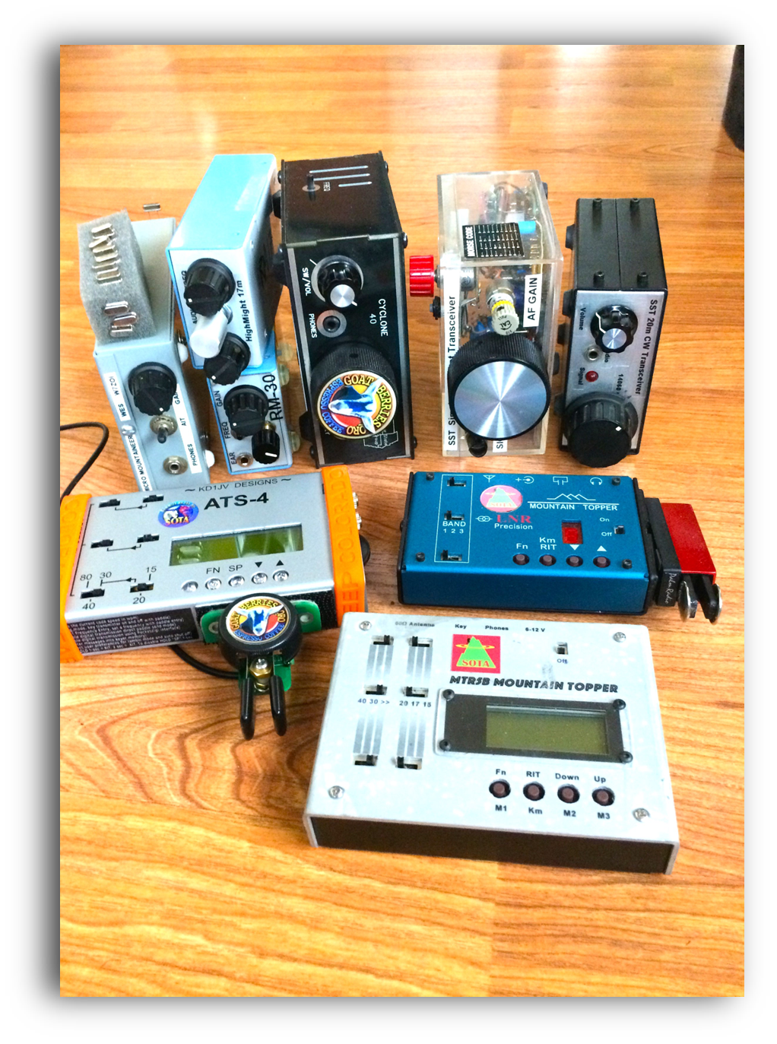
HF Radios
Small is GOOD
Light Batteries
Built in ATU
Low current RX
Multi mode
Small
No ATU
High Current RX
Affordable
Multi mode
CW only
No ATU
Very small and Light!

Slide 33
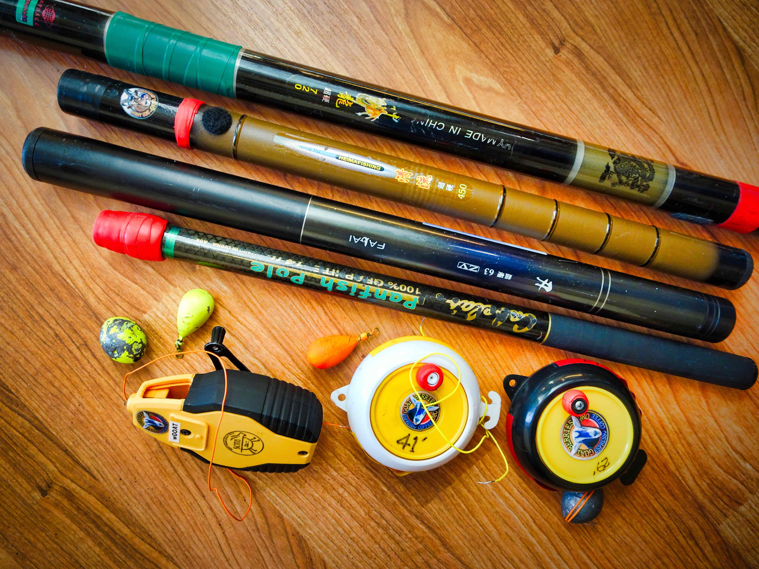
HF Antennas and poles
Steve WGoAT

Slide 34
Tech on the go!
Cell Phone Apps!
iPhone
SotaGoat
Pocket SOTA
Hamlog/Pignology
HAMRS logging
Android
Pocket SOTA
SOTA Finder
HAMRS logging

Slide 35
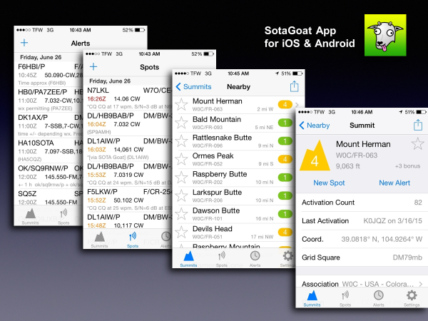
One of my Favorite apps!

Slide 36
Summits on the Air
How did it start?
What is it?
How do I participate?
Can I get any awards?
How do I start activating and what equipment should I use?
Safety and Operating

Slide 37
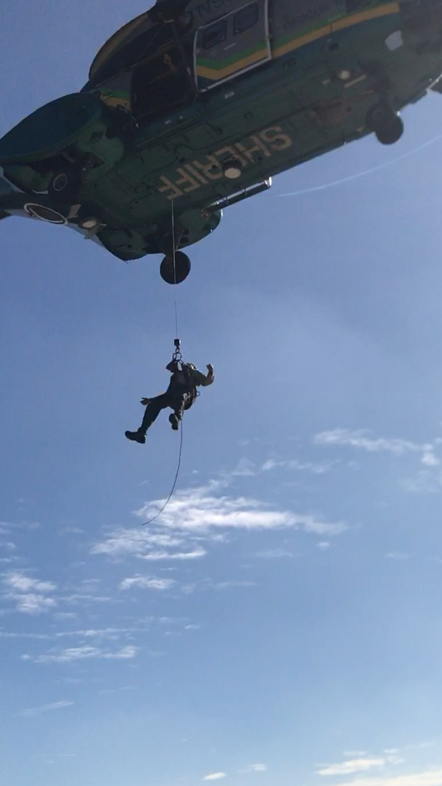
Mountain Safety
Weather /Lightning
Getting Lost
Gravity
Temperature
Rescue can be hours OR days away
Warning: Climbing mountains is inherently a dangerous activity. Do not attempt this without proper training, equipment and preparation.
AK6Q in previous assignment

Slide 38
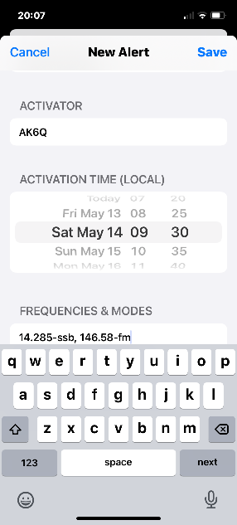
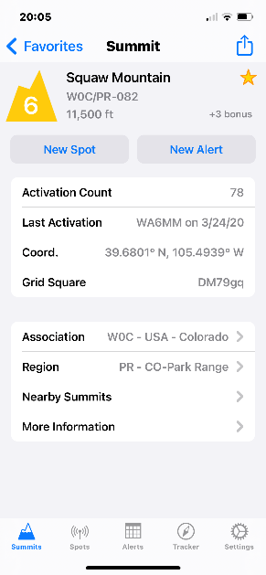
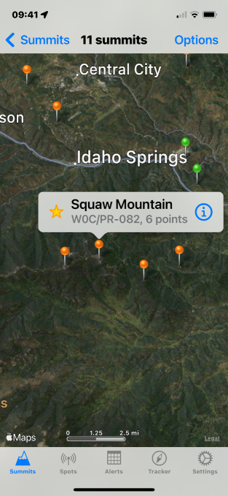
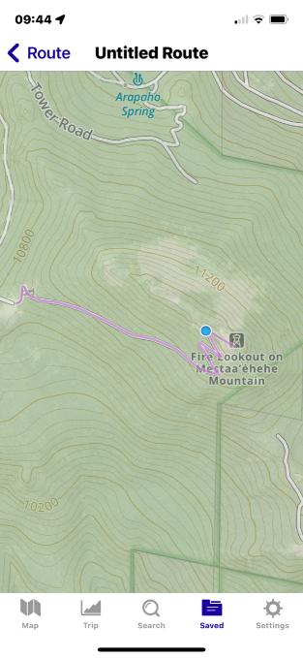
So now what…..How do I start?
PREP
Chose a peak of interest ( close to a destination maybe?)
Look up data from SOTA apps (SOTA Goat)
Plan a route (GAIA GPS app and desktop)
Weather check for day of activation
Verify your equipment: Radios, Batteries, antenna, logging
SAFETY GEAR, Weather Gear, Map, Compass, GPS, Cell/HT Batts, Food, Water, Clothes, Poles, Bivy?
Create an alert for the activation (SOTA Goat)

Slide 39
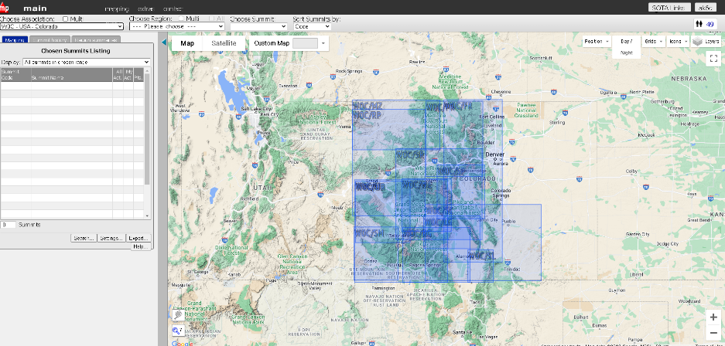
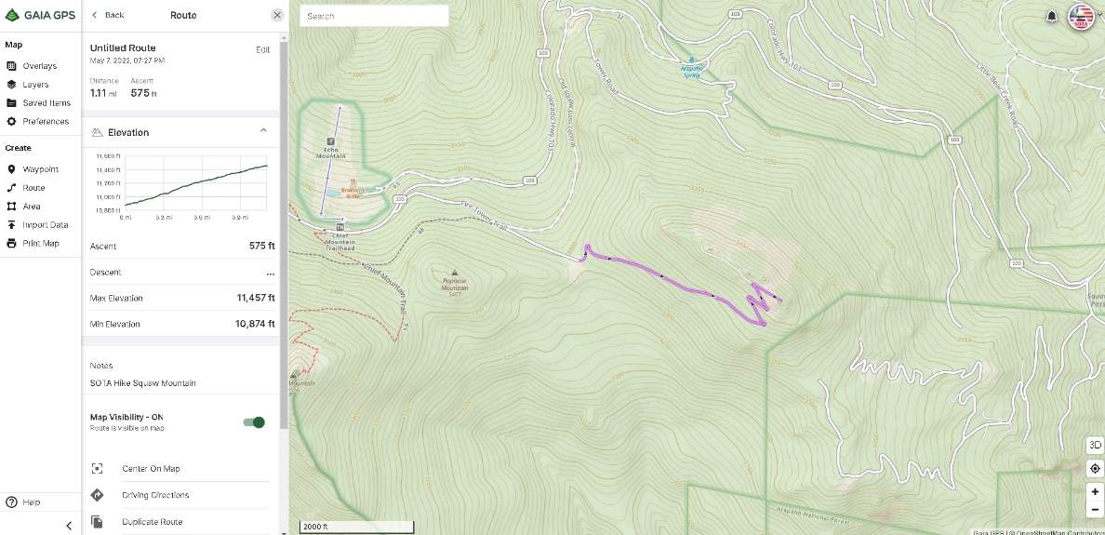
Some at home resources
www.SOTAMAPS.org
Identify peaks
Plan trip and routes
Gives peak info
www.GAIAgps.com
Links to phone app with routes, maps driving directions…

Slide 40
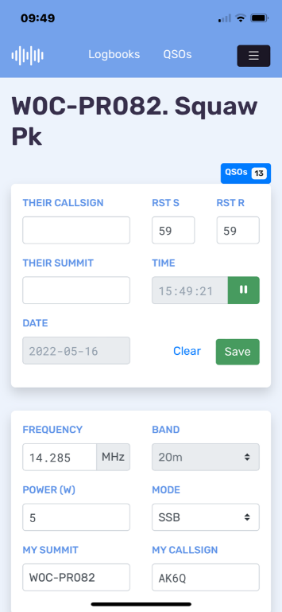
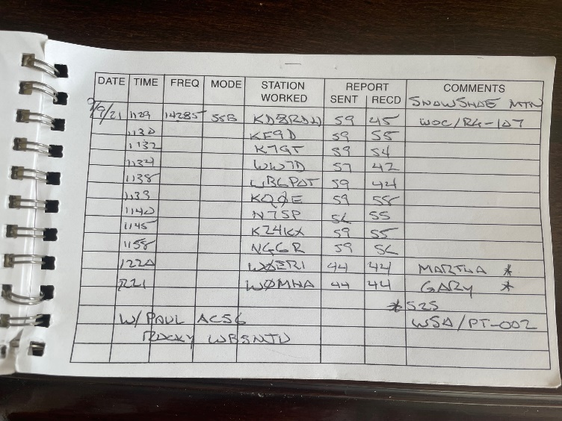
ACTIVATION DAY
Verify you have your gear in pack
Know your route and timing
Watch the weather, and enjoy the journey!
Set up on summit
Spot if possible Cell, APRS…. Ask a contact to spot you!
Log your QSO’s
Paper Log or notes (pencil?)
HAMRS…… (ADIF)

Slide 41
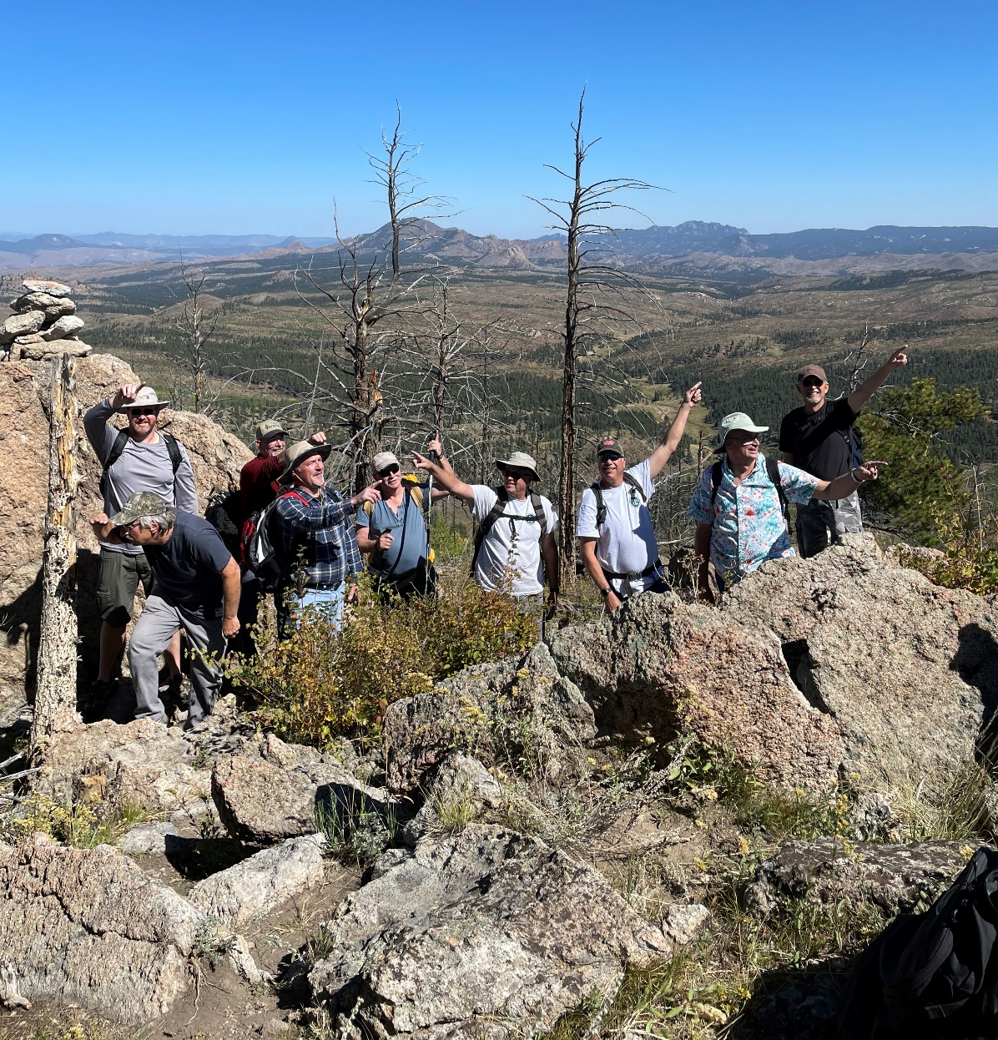
Signal Butte Summer Trip

Slide 42
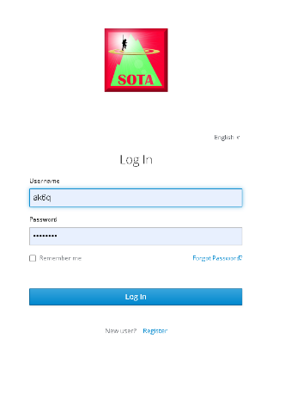
Now what to do with that log?
Use SOTA Data Base for tracking
www.sotadata.org.uk/en/
Paper Logs scan be manually entered
Import an ADIF File

Slide 43
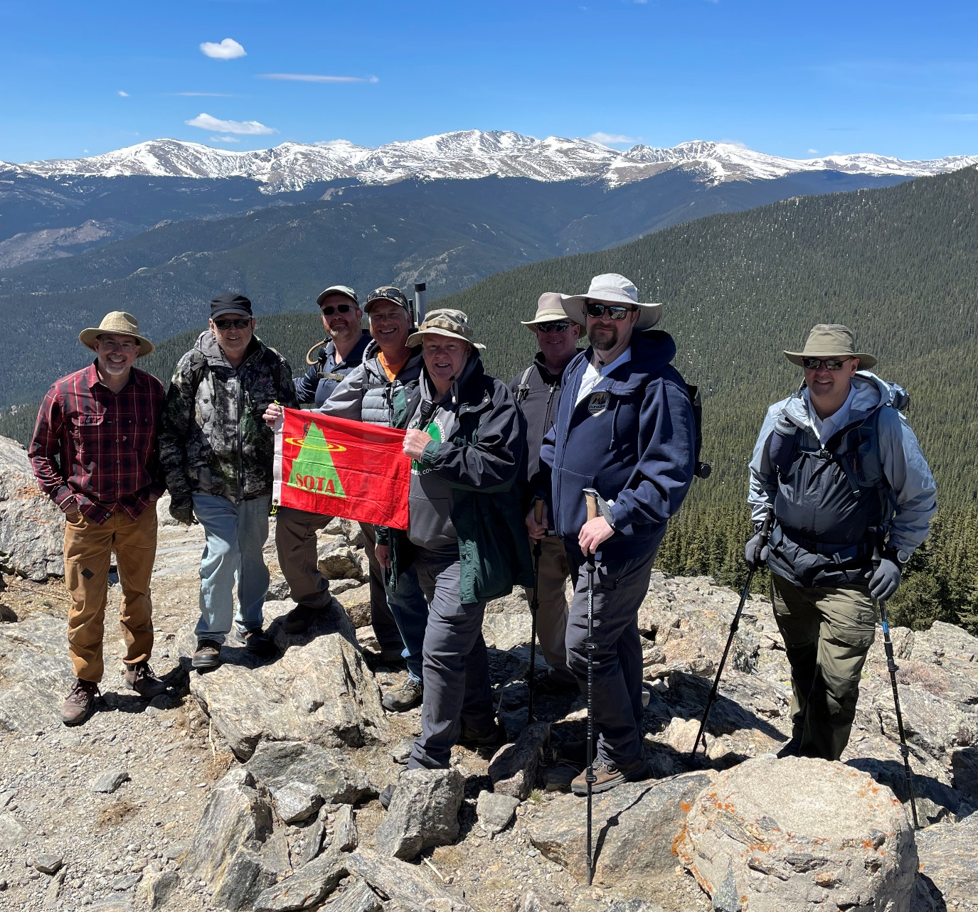
Squaw Peak (Mestaa`ehehe)

Slide 44
Lets do SOTA!
You don't have to be a mountaineer!
Some summits you can drive near the top
You can participate as a Chaser from your shack
But if you are...
There are many first expeditions yet to be done
It's a good excuse to enjoy the outdoors on the summit looking at the views
It's a great way to bring two hobbies together
Be careful it is ADDICTIVE!!!

Slide 45
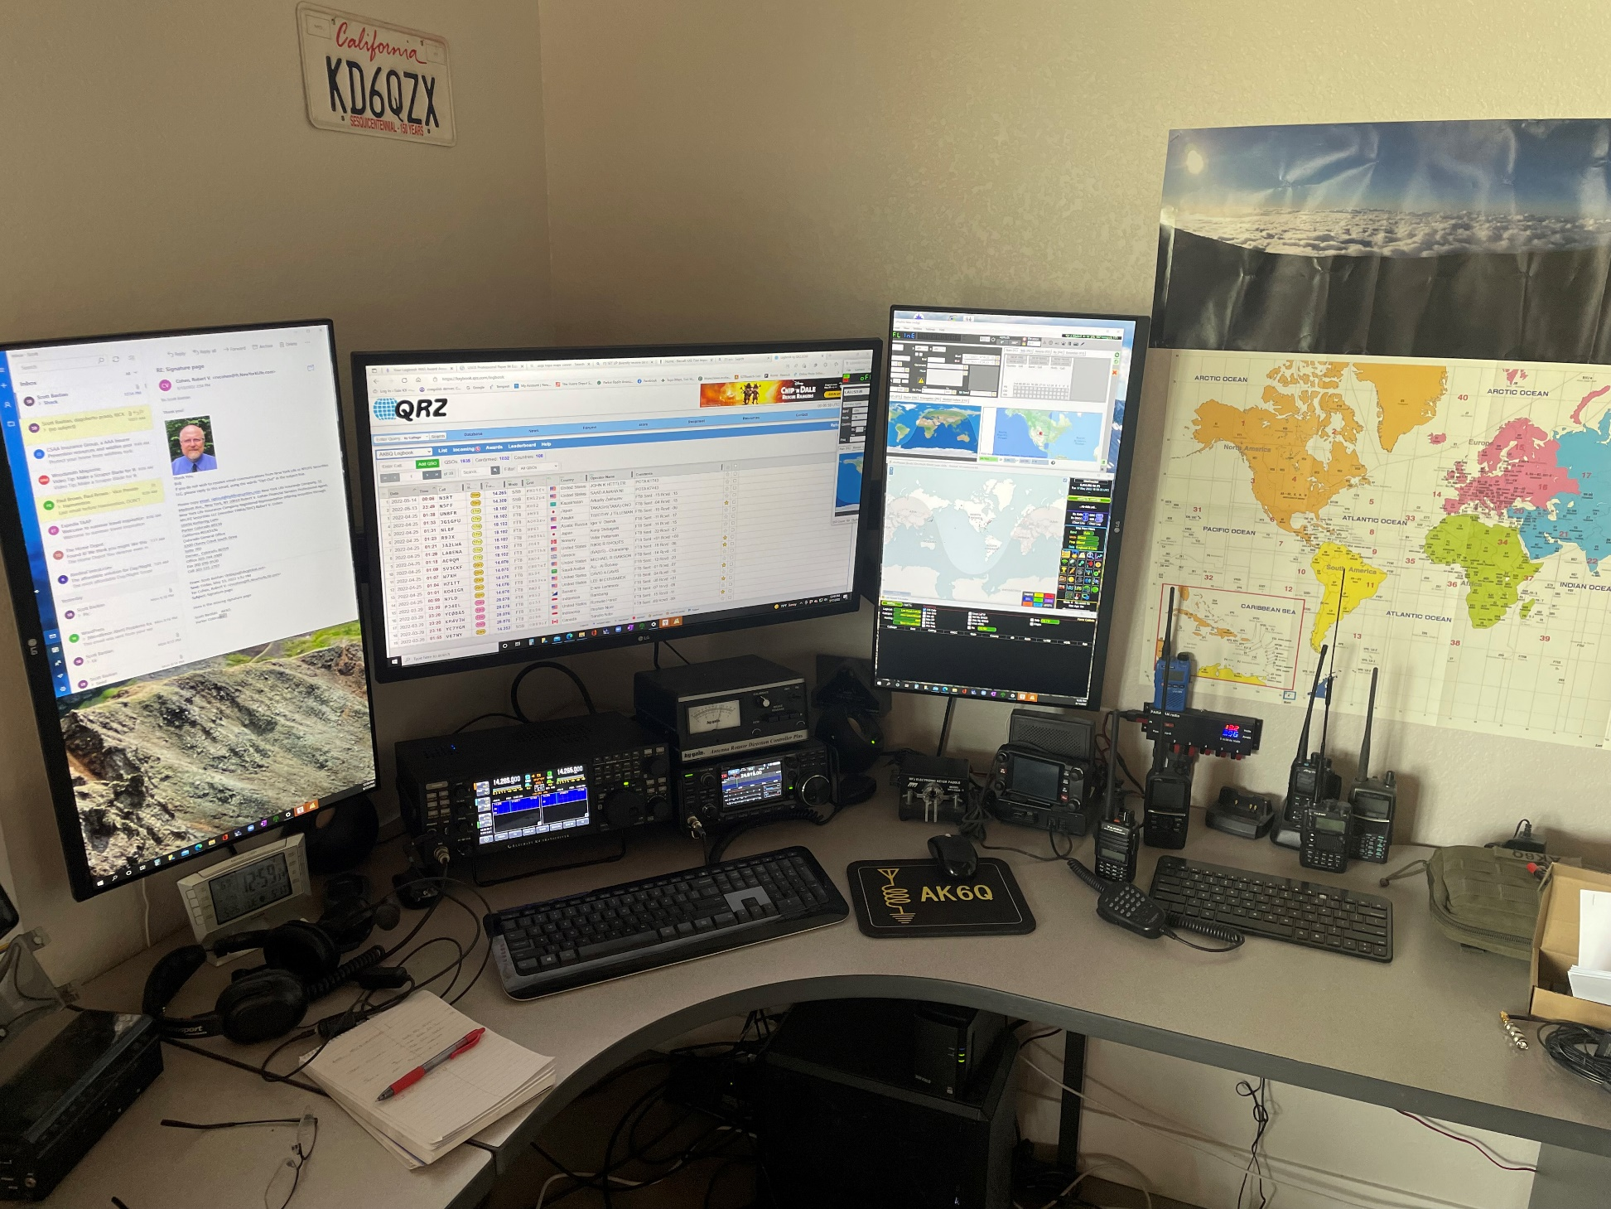
Maybe Just Chase ???
Is it the points/awards? ...Bragging rights?
Fine tuning and keeping your station/
antenna in peaked performance?
Respect? Payback for being chased?

Slide 46
Why Chase
Responses
Larry K0RS:
Chasing QRP stations with improvised antennas...frequently on another continent...is a real DX challenge. Pulling a weak signal from the noise teaches one how to get the most from one's radio as well as fundamentals of propagation. And a dose of patience as well. The problem is, SOTA is addicting.
Paula K9IR:
When you chase summit activators, you can:
Join over 6,300 other hams in the chase, nearly 4,000 of them also activate summits.
Enjoy making contacts and qualifying for awards without needing a super-station.
Improve your ability to tune in, hear and work weak signal stations.
Help activators log the required minimum 4 QSOs

Slide 47
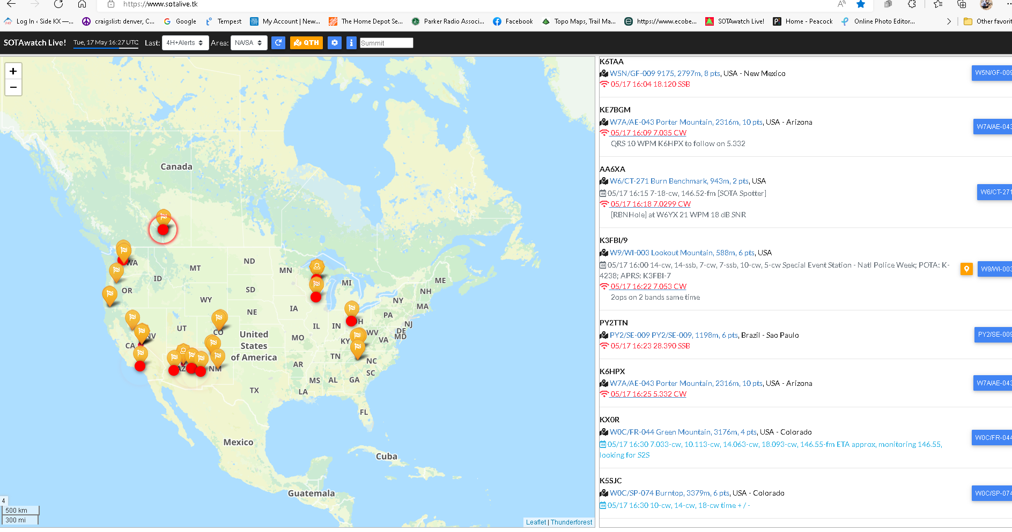
Chaser Tools
www.SOTALIVE.tk

Slide 48
Questions?
www.sota.org.uk
www.sotawatch.org
http://groups.yahoo.com/
WØC SOTA (w0c-sota.org)

