Slide 1
Parks on the Air
Parker Radio Association
July 2022
Presented By: Cameron Melvin (AD1CT)

Slide 2
OVERVIEW
What is Parks on the Air (POTA)
Who is POTA
How to get involved
Hunters vs Activators
Activators
Hunters

Slide 3
What is POTA?
POTA is a 501(c)3 radiosport program that encourages communications to and portable operations from state, provincial, nationally and internationally managed public lands.
POTA has a large set of references and a short set of rules. We welcome you to join us as an activator, chaser or both!
Very similar to Summits on the Air (SOTA) with a few small differences

Slide 4
Who is POTA?
POTA started as a small group of USA based dedicated volunteers who created the rules, infrastructure and database. POTA then acquired volunteers to coordinate the call areas and social media. And POTA is growing every day.

Slide 5
How to join the POTA fun!
Creating an account is fast and easy.
http://www.parksontheair.com
POTA stores no passwords, we authenticate against accounts you already have.
Select the Dashboard/Login link at parksontheair.com
Email: info@parksontheair.com if you need assistance

Slide 6
Activators
The Amateur Radio Operator out in the park
Choose a reference to put on the air.
Currently the database has
36,370 global references
9,762 references in the United States
187 references in CO
13 references in around the Denver metro area
Find the list and maps at parksontheair.com

Slide 7
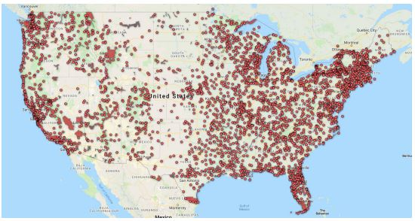
US POTA Map

Slide 8
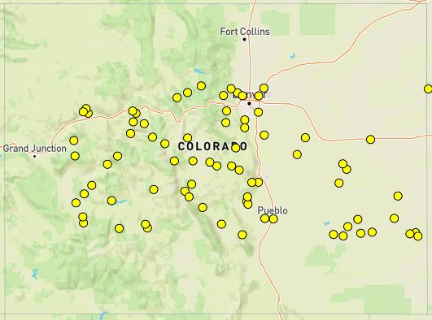
Colorado POTA Map

Slide 9
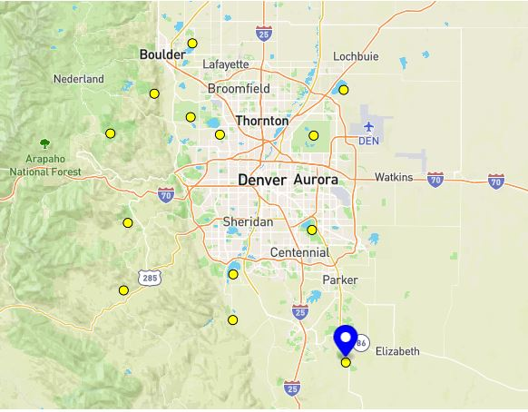
Local POTA Refrences
K-9669: Sawhill Ponds State Wildlife
K-1216: AreaEldorado Canyon State Park
K-1209: Barr Lake State Park
K-1219: Golden Gate Canyon State Park
K-0225: Rocky Flats National Wildlife Refuge
K-0227: Two Ponds National Wildlife Refuge
K-0226: Rocky Mountain Arsenal National Wildlife Refuge
K-9613: Bergen Peak State Wildlife Area
K-1213: Cherry Creek State Park
K-1244: Staunton State Park
K-1212: Chatfield State Park
K-1238: Roxborough State Park
K-1211: Castlewood Canyon State Park

Slide 10
Rules for Activators
HAVE FUN!!
All equipment must be within the perimeters of the park, and on public property
Use the map on the POTA site in combination with Google Maps, and official park sites to find the official boundaries
The park must be OPEN/have permission from the administration to be there.
An activation requires to QSOs, any band, any mode. NO Repeaters
Activators are the ones responsible for uploading logs.
Logs are uploaded on the POTA.app

Slide 11
What do I need to activate a POTA reference?
Amateur radio license
Any radio
Any portable antenna
Portable power or access to AC power
Any logger that will export an ADIF
or a paper log and the ability to convert later
A desire to have fun!!
Popular antennas are homebrew wire on a self supporting mast, Wolf River Coils, Alpha Antennas, SotaBeams, Screwdrivers and many more.

Slide 12
How do I activate a POTA reference?
Make 10 QSOs on one UTC day while inside the boundaries of the park on any band your privileges allow including WARC bands.
Utilize any simplex mode including satellite. No terrestrial repeaters allowed.
POTA recommends operating in the General bands but has no specific calling frequencies.
There is no specific exchange beyond callsign, although the traditional RST is usually given along with QTH. If you prefer, you do not have to call CQ POTA or announce you are at a park.

Slide 13
How do I activate a POTA reference?
Log the date, time, and band in your favorite logging program and export as an ADIF.
Submit your logs via the POTA.app website
or
Submit your logs to the appropriate Regional Coordinator via email based on the numeric in the activators call sign to KX@parksontheair.com where X is the number in the activators call.

Slide 14
Why would you enjoy portable activation?
Typically a lower noise floor and very often beautiful views and opportunities for wildlife watching.
Every activation has different challenges: terrain, space constraints, weather, accessibility.
It’s an opportunity to perfect your portable radio kit, always evolving it to suit your operating style.
It makes you a better operator and keeps your skills sharp.
You will make friends all over the world
Its Field Day every time you go out and play radio

Slide 15
Hunters
These are the awesome folks make contacts with the activators
Go to the POTA.app website to see who’s out activating a park
Spin the dial, and wait for the Activator to call CQ
A Special type of Hunter is a Park to Park where the hunter is also out activating a Park
Note: They can be in the same park.

Slide 16
Other reasons people enjoy POTA
POTA is accessible. There are references near most populated areas, and many you can drive right in and activate from your vehicle.
Activators can run rapid-deployment contest-style activations or ragchew from a favorite campground all weekend.
POTA accepts logs from any time, if you chased POTA you may already have confirmed contacts.
The POTA stats pages and maps are under continuous development with many more features planned. All modes are welcome.

Slide 17
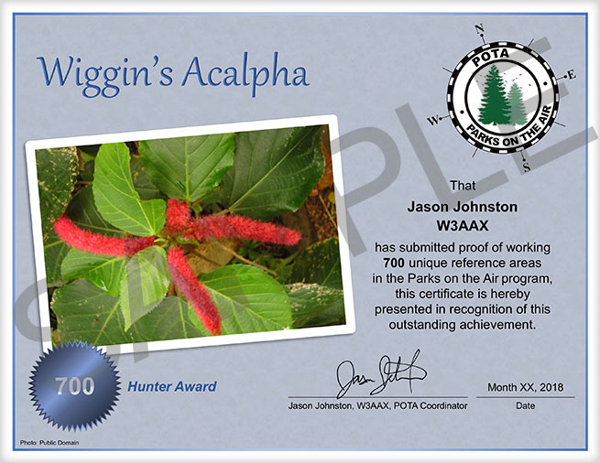
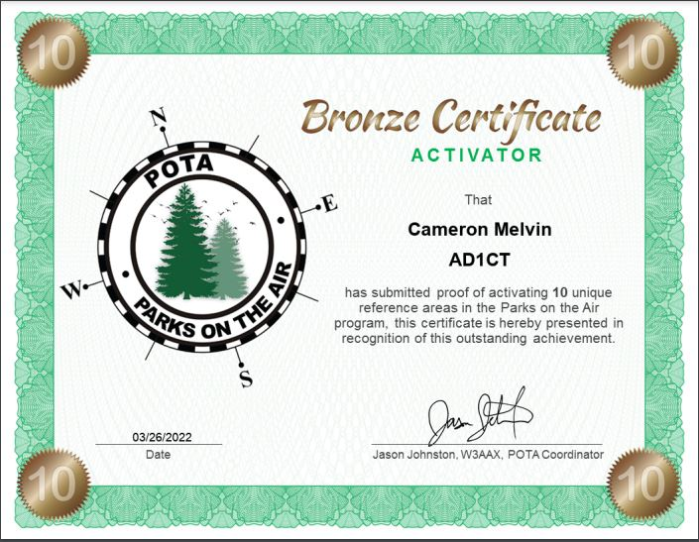
Activator Awards
Incremental awards, for each level of unique parks activated.
Unique Reference Award

Slide 18
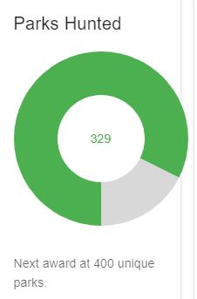
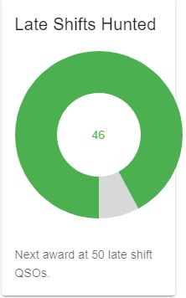
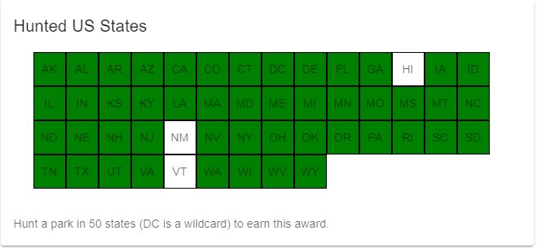
How does it work for Hunters?
Create an account at parksontheair.com
Make the QSO & a post a fresh spot if warranted
No log submission is necessary
Check your dashboard for stats at parksontheair.com

Slide 19
Tips for Hunting
Check the POTA Scheduler for any planned activations
Follow our social media for pop-up activations
POTA has a Facebook group/page
Watch the POTA spotter at http://pota.app
Sign up for Slack to receive instant POTA spots on your phone or desktop
Use phonetics or QRS if necessary
Observe the DX Code of Conduct
Spot to the POTA spotter or if you prefer to a cluster with comment: POTA K-1234 (or VE-1234)

Slide 20
Why would you enjoy hunting POTA activators?
You are helping another amateur to reach their goals
It’s an easy, short contact - great for new HF operators.
Enjoy the comprehensive stats and awards POTA provides.
It requires no log submissions
It makes you a better operator and keeps your skills sharp.
You will make friends from all over world
You can hunt as much or as little as you want, you do not even have to register to play.
You can help the activators by relaying things like “you have a Park to Park calling” or by spotting when they QSY

Slide 21
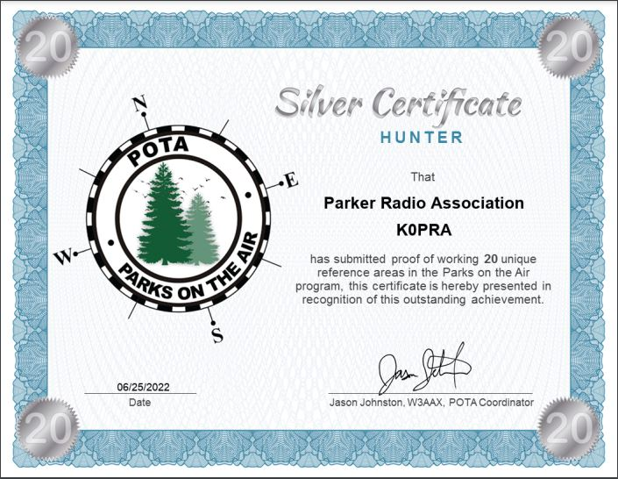
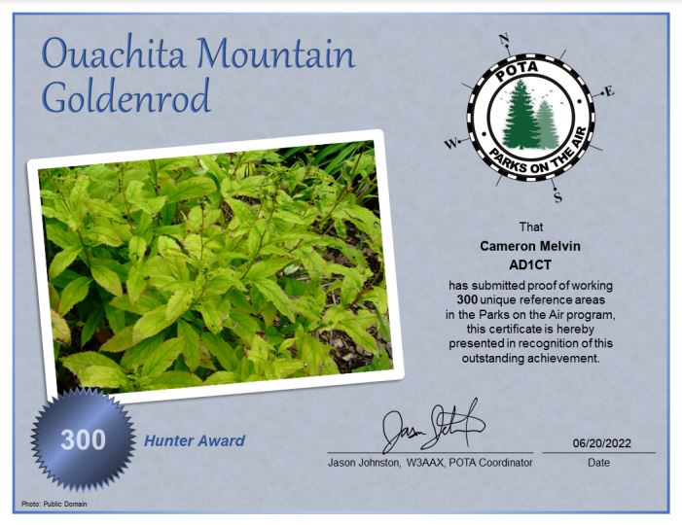
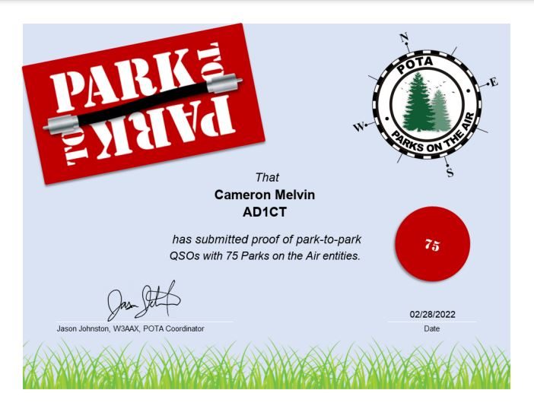
Hunter Awards

Slide 22
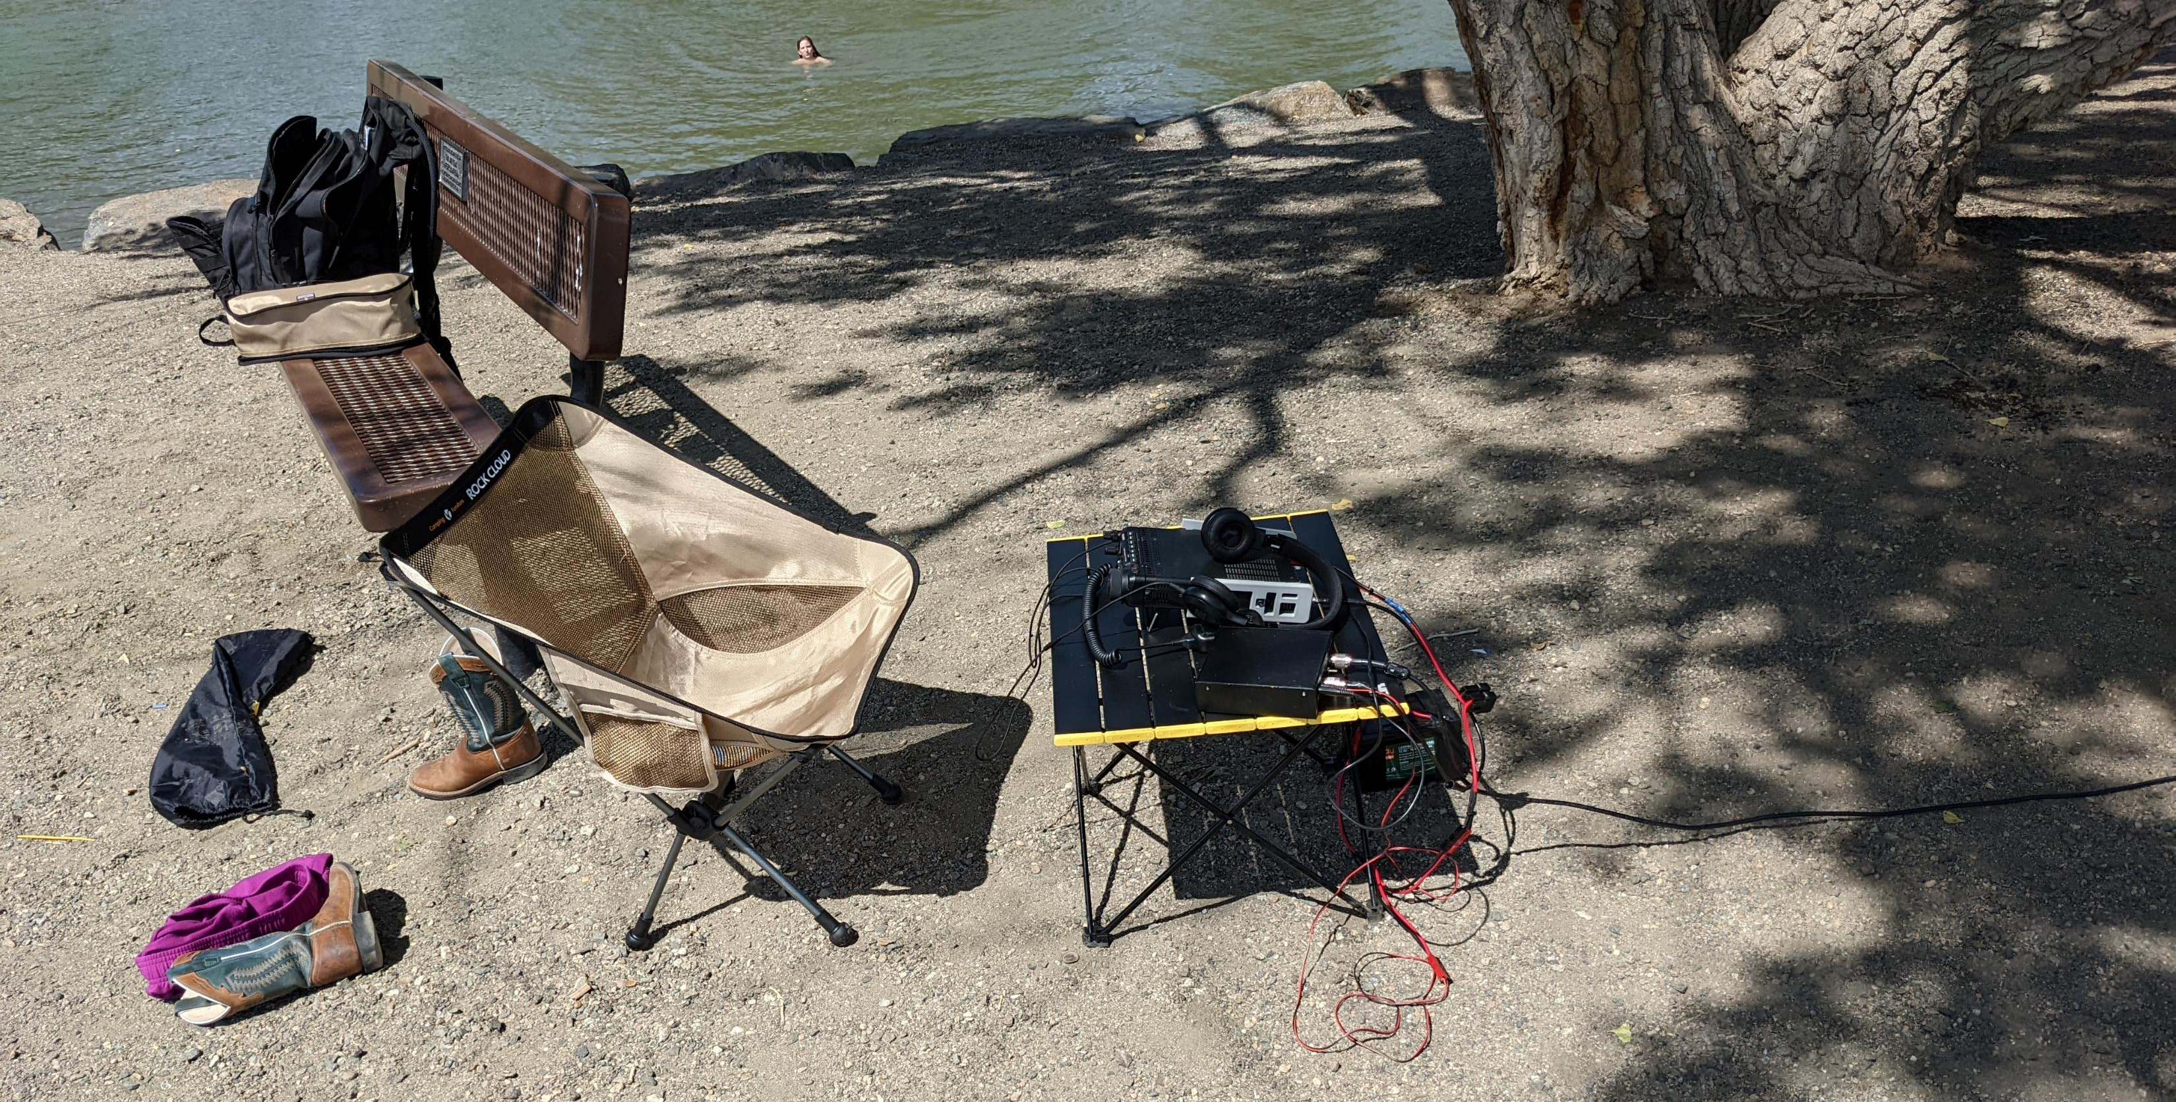
My POTA Set-Up
Radio: Yaesu FT-891
Antenna: Wolf River Coil Mini
Tuner: LDG Z100+
Battery: Miady 16AH LiFePo4
Log: HAMRS Android App

Slide 23
Questions?
Join the fun!
www.parksontheair.com
www.facebook.com/groups/parksontheair
www.parksontheair.slack.com

